Slide 1

Airbnb Host Retention
Group 3

Slide 2


Problem overview
Airbnb wants to predict which hosts in a particular city will de-list their property
It wants to target certain hosts with a $1000 gift to retain them
Assumptions: Airbnb receives 15% of a host’s revenue; all hosts receiving the gift will be retained; revenue remains unchanged from previous year
Objective: To create a list of hosts to whom the gift should be given to maximize Airbnb’s net profit
Two important factors to be noted:
If a host gives very little revenue to Airbnb, then retention effort does not make sense
If a host gives an enormous revenue to Airbnb, then retention effort makes sense even if the churn probability is low

Slide 3
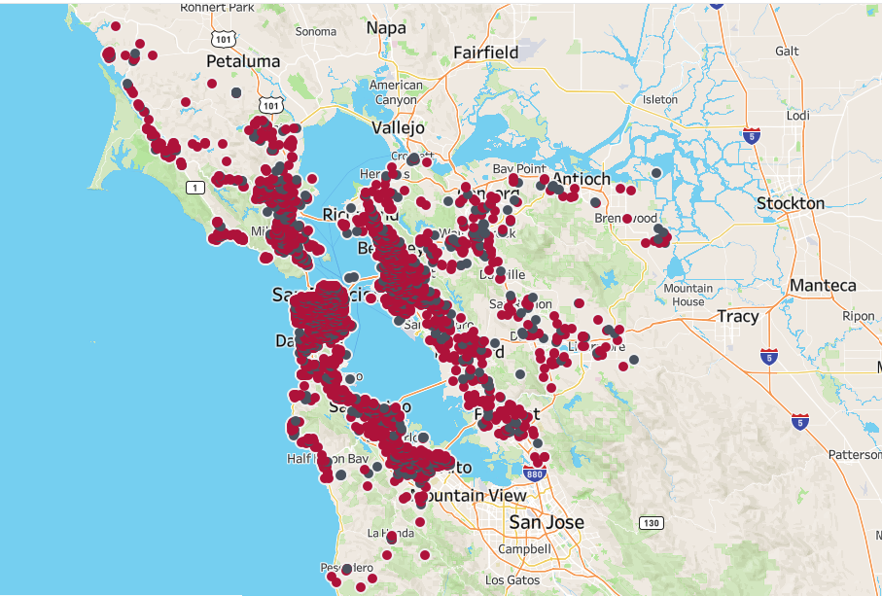
Exploratory data analysis
Following observations were made from exploring the training data:
Airbnb earned an average of $4735 last year from the hosts, with the most profitable host generating $96,949
The hosts who churned had, on an average, fewer reservation days in all months than the hosts who continued
Assuming ‘nmon’ to denote the vintage of a host in months, it was seen that the newer hosts are more prone to de-listing their property
The distributions of the other variables (such as rating, number of bedrooms / bathrooms) are almost indistinguishable between the hosts who churned and those who did not

Slide 4

Logic to determine gift recipients
STEP 1: Use model to predict the probabilities of churn (and hence retention) for every host
STEP 2: Calculate the expected revenue from each host if all the churning hosts are retained. This is exactly equal to the revenue given by them last year. Let’s call this Rev1.
STEP 3: Calculate the expected revenue from each host if there is no retention effort. This is equal to retention probability multiplied by last year’s revenue. Let’s call this Rev2.
STEP 4: Take the difference between these two values, Diff = Rev1 – Rev2
STEP 5: If the difference (Diff) is greater than $1000, then give the gift to that host

Slide 5
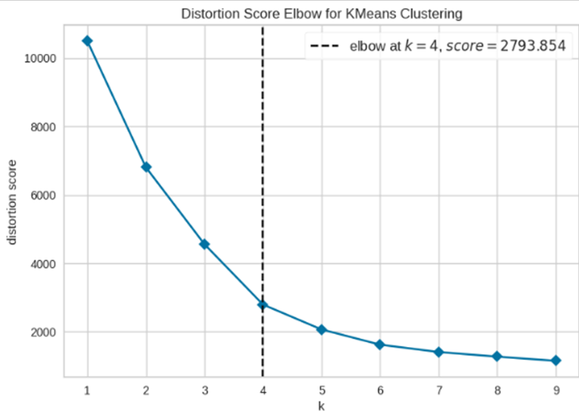
Feature engineering
We used the latitude-longitude coordinates to create 4 clusters of hosts, using K-Means Clustering method. The same clusters were fitted in the test data (abb_new) as well so that ‘cluster’ may be used as a predictor after converting to dummies.

Slide 6
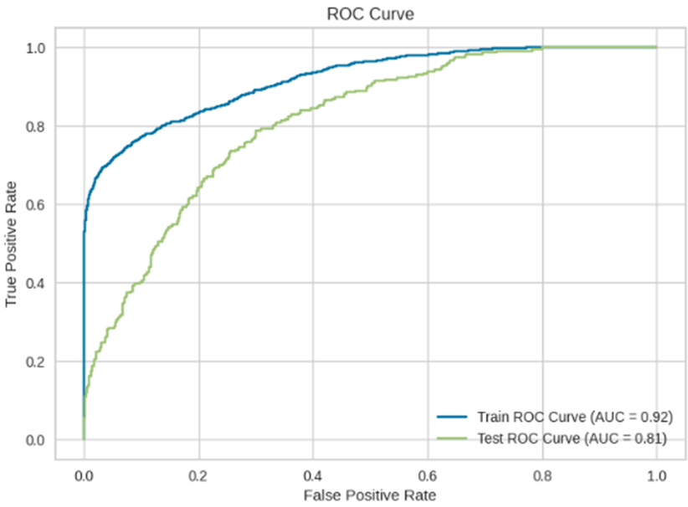
Churn prediction
Models tried: We tried different supervised learning models such as Logistic Regression, Decision Tree, Random Forest and Gradient Boosted Trees
Final model: The best performing model was a Random Forest model with a validation ROC-AUC of 0.81
Details of the model:
max_depth = 8 max_features = 0.5 max_samples = 0.7 n_estimators = 500

Slide 7
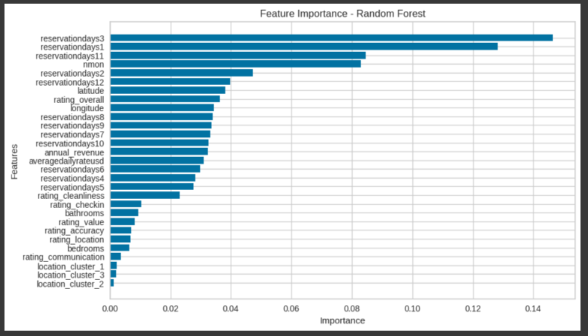
Feature importance

Slide 8
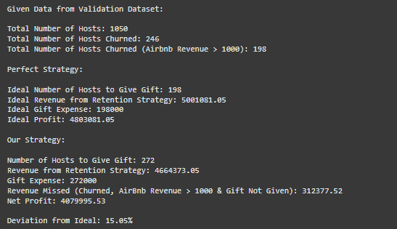
Code output excerpt

Slide 9
Final results (based on abb_new)
Specifics | Value
Total number of customers | 1312
Gift to be given to | 334
Total retention effort expenditure | $334,000

Slide 10
Thank you!

